Slide 1
ADDRESSING CLIMATE CHANGE DENIAL IN THE CLASSROOM
Practical actions

Slide 2
Tackling climate denial in the classroom
The Impartiality Guidance issued by the DfE makes clear that climate change denial has no validity and teaching about climate change, the scientific facts and evidence behind it, does not constitute teaching about a political issue.
Schools do not need to present misinformation, such as claims that climate change is not occurring, to provide balance.
The Climate Schools Programme is designed so you can spend time teaching about the solutions instead of debating the existence of human-made climate change.
These arguments may arise anyway. In this document we give you some practical techniques to counter climate denial from a student.
Notes:
https://www.gov.uk/government/publications/political-impartiality-in-schools/political-impartiality-in-schools#teaching-about-political-issues

Slide 3
Why do some people deny climate change?
In most cases, the root of climate change denial is that some people are worried about the impact on their lives. That's understandable, because climate change calls for large scale changes to the way we live. It’s important to address any climate denial without increasing anxiety or a sense of personal responsibility to tackle climate change.
The Climate Schools Programme is a great way to explore climate change as it focuses on the efforts that are already being made to tackle climate change and the careers young people can get involved with when they grow up, rather than individual actions they can take now.
Notes:
What are climate misinformation and disinformation and how can we tackle them? | UNDP Climate Promise

Slide 4
Set up an open classroom
Potentially disruptive conflict can often be avoided by establishing a classroom atmosphere that welcomes debate and dialogue. In many cases, friction arises when people do not feel respected or listened to. Be open to questions and have a willingness to explore more deeply.
For example, students expressing negative views of electric vehicles because the batteries cannot currently be recycled is a valid worry. Encourage that student to explore who is doing or researching car battery recycling.

Slide 5
Set up an open classroom
Try to avoid making judgemental comments about people, companies or countries that have high carbon footprints. Appeal to evidence instead.
For instance, it is true that China is currently a major producer of carbon dioxide emissions but over the last 200 years, the nation with the highest carbon footprint is easily the USA. Even today, the amount of carbon dioxide emitted per head is lower in China than in the USA.
Notes:
Future Earth Newsletter Climate Q&A: Emissions, volcanoes and EVs - BBC News

Slide 6
Procedural neutrality
Approaches for teaching controversial topics such as climate change have been set out in Reiss, 2022. Using an advocacy approach where the teacher argues for the position they hold closes down debate and student autonomy and critical thinking. Affirmative neutrality, presenting all sides of an argument, is not necessary in the case of climate change as there is overwhelming evidence and scientific consensus that human-centred climate change is happening.
Procedural neutrality is a good alternative approach, where you as the teacher act as a facilitator to elicit student responses from source material without revealing your position. Assembling relevant and reliable source information is difficult, but luckily the Climate Schools Programme has done that for you in science, geography and English.
Notes:
Reiss, M.J 2022. Learning to teach controversial topics. In: Handbook of Research on Science Teacher Education, Luft, J.A & Jones, M.G (eds). Routledge, New York pp. 403-413. DOI:10.4324/9781003098478-36

Slide 7
The inoculation approach
Inoculation theory takes the concept of vaccination, where we are exposed to a weak form of a virus in order to build immunity to the real virus, and applies this theory to the field of knowledge. You can inoculate your students against climate misinformation by following this approach.
Inoculating requires two elements.
First, it includes an explicit warning about the danger of being misled by misinformation.
Second, you need to provide counterarguments explaining the flaws in that misinformation.
The Climate Schools Programme English lesson on climate misinformation follows this approach.
Notes:
Inoculation theory: Using misinformation to fight misinformation

Slide 8
Example 1: inoculation approach
You could share an article about a petition that was circulated in 2016 citing 31,000 scientists who denied that humans were affecting the climate.
Inoculate students using the following statement before sharing.
“Climate misinformation often uses ‘fake experts’ to back up their claims. Have a look at this article and tell me what you think.”
Then share the issues (and a rebuttal article)
Most of those who signed the petition were not climate scientists, they were science graduates
Some of the people on the petition were fake
31,000 people is less than 1% of all science graduates.
Notes:
Inoculation theory: Using misinformation to fight misinformation

Slide 9
Example 2: inoculation approach
You could share an article that claim that we can dismiss climate science because in the 1970s scientists warned we might face a new Ice Age instead of global warning. Inoculate using the following statement before sharing.
“Climate deniers often use the ‘straw man’ argument to back up their claims. This means that they misrepresent the claim so they can easily disprove it. Have a look at this article and tell me what you think.”
The issues with this claim are that:
It was a small number of scientists who claimed this in the 1970s
99%* of climate scientists today agree about climate change caused by global warming
This approach can also lead to a debate about the nature of scientific enquiry - gathering robust evidence that can prove, modify or disprove previous theories.
Notes:
*99% of climate scientists agree about climate change being caused by global warming

Slide 10
Example 3: inoculation approach
You could share an article that claims that climate scientists benefit financially with continued funding for claiming climate change is real.
Inoculate using the following statement before sharing.
“Climate deniers often use an ‘ad hominem’ attack to counter climate scientists. This means that they attack the motives or character of a person to try to show they shouldn’t be trusted. Have a look at this article and tell me what you think.”
The issues with this claim are that:
Climate scientists can provide evidence to back up their claims
Those who attack climate scientists are often themselves funded by people who would benefit from doing nothing to tackle climate change

Slide 11
Classroom conflict
What if, despite all this preparation, climate denial still arises in your classroom?
First of all, it is important to remember that the origins of this misinformation may be from family members or friends. It's important to not disparage the sources of misinformation, so as not to unintentionally criticise students or their friends and families.
Notes:
Controversy in the Classroom: Strategies for managing climate change discourse

Slide 12
Classroom conflict: how to diffuse
Listen fully to the student’s concern or question. Respect their intelligence and their values.
Ask clarifying questions to understand their perspective. Strive to make the questions open-ended and inquisitive, rather than 'gotcha'-style questions.
Reflect on what you're hearing back to them.. Acknowledge the student’s point of view.
Ask them about their evidence
Share your knowledge or perspective in ways that are directly relevant to their concerns. Be factual. Leverage areas of easy agreement (see next slide).
Use facts and stories that are relevant to your audience.
Notes:
Controversy in the Classroom: Strategies for managing climate change discourse

Slide 13
Example scenario
A student claims that human-caused climate change isn’t real because the earth has always warmed and cooled naturally.
You could respond:
“It is true that the earth has warmed and cooled over long periods of time. Can you give us more details about the earth’s climate?”
“Thank you. It is really important to have this knowledge so we can check the evidence being gathered today to see if this climate change we’re experiencing is different. That shows excellent scientific reasoning.“
“That’s exactly what climate scientists have done. The rapid warming we’re seeing now can't be explained by natural cycles of warming and cooling. The kind of changes that would normally happen over hundreds of thousands of years are happening in decades – and for very different reasons.”
Notes:
Controversy in the Classroom: Strategies for managing climate change discourse

Slide 14
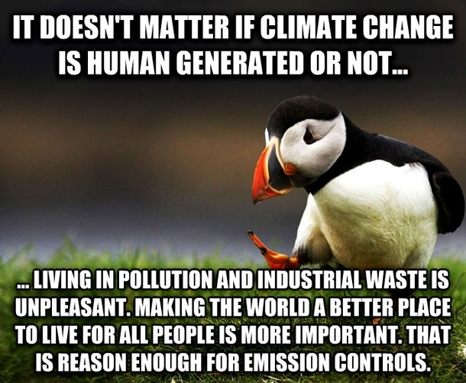
Other arguments for taking action for climate
Transitioning to renewable energy sources helps with national security (see Solar Supports Ukraine or Patriotic pumps) and lowers our dependence on fluctuating energy supply from abroad
By taking action to reduce pollution, the world will be a better place for all people (the meme on the right is used in the Climate Schools Programme English resources ).
By taking action to reduce the use of fossil fuels, the world will also be a better place for wildlife with fewer oil spills and less plastic in the ocean (plastic is made from crude oil and natural gas)
Notes:
Integrating sustainability into climate finance by quantifying the co-benefits and market impact of carbon projects | Communications Earth & Environment

Slide 15
Fact-checking incorrect climate claims
You are not expected to know every aspect of climate change science and how we mitigate and adapt to it. Be willing to say you don’t know the answer to some questions and try and work out an answer together. Here is a list of trusted sites that help tackle the most commonly shared climate misinformation:
RealClimate: Index
Environment – Full Fact
BBC’s Future Earth newsletter
Factchecks - Carbon Brief
For a factual review of climate headlines:
Daily Briefing of climate headlines from Carbon Brief
This website also helps you get to grips with the pros and cons of climate mitigation technologies:
Drawdown® Explorer | Project Drawdown®
Notes:
Further reading:
Stott, P 2022. Hot Air: The Inside Story of the Battle Against Climate Change Denial. Published by Atlantic Books. ISBN: 9781838952518.
Reiss, M. J. (2022) Learning to teach controversial topics. In: Handbook of Research on Science Teacher Education, Luft, J. A. & Jones, M. G. (Eds), Routledge, New York, pp. 403-413. DOI:10.4324/9781003098478-36

Slide 16
We’ve got your back
If all else fails, you can’t find an answer to a difficult question or are unsure about the reliability of climate claims, contact us at:
climateschools@eukeducation.org.uk

